Slide 1


Slide 2
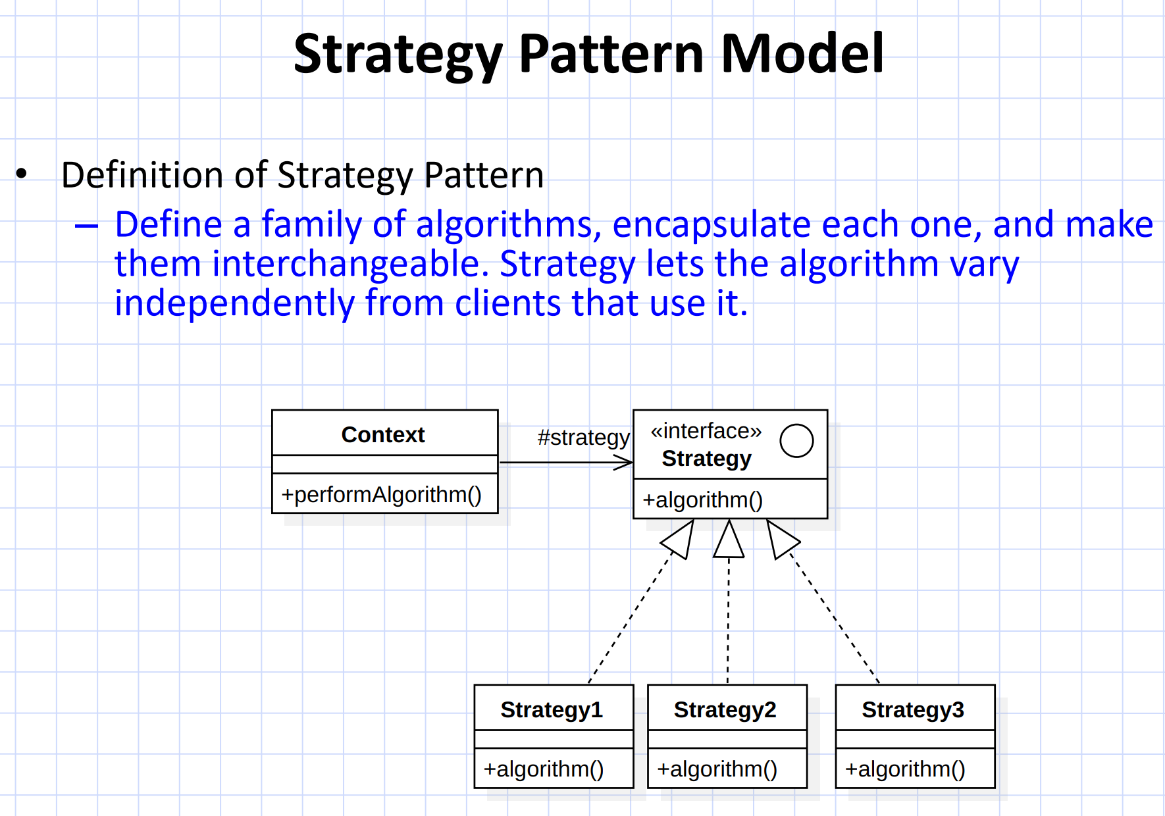

Slide 3


Slide 4

Strategy Interface
public interface SortingStrategy { void sort(List<Integer> numbers); }

Slide 5
Define a set of algorithms
Bubble Sort
Insertion Sort
Bubble Sort
Merge Sort

Slide 6
Encapsulate each one
public class BubbleSortStrategy implements SortingStrategy { @Override public void sort(List<Integer> numbers) { // Bubble sort logic } } public class QuickSortStrategy implements SortingStrategy { @Override public void sort(List<Integer> numbers) { // Quick sort logic } }
Bubble Sort
Insertion Sort
Bubble Sort
Merge Sort

Slide 7
Context Class
public class Sorter { private SortingStrategy strategy; public Sorter(SortingStrategy strategy) { this.strategy = strategy; } public void setStrategy(SortingStrategy strategy) { this.strategy = strategy; } public void sortNumbers(List<Integer> numbers) { strategy.sort(numbers); } }

Slide 8
Client Code
public class Main { public static void main(String[] args) { List<Integer> numbers = Arrays.asList(5, 3, 2, 8, 1); Sorter sorter = new Sorter(new BubbleSortStrategy()); sorter.sortNumbers(numbers); // Switch to a different strategy sorter.setStrategy(new QuickSortStrategy()); sorter.sortNumbers(numbers); } }

Slide 12
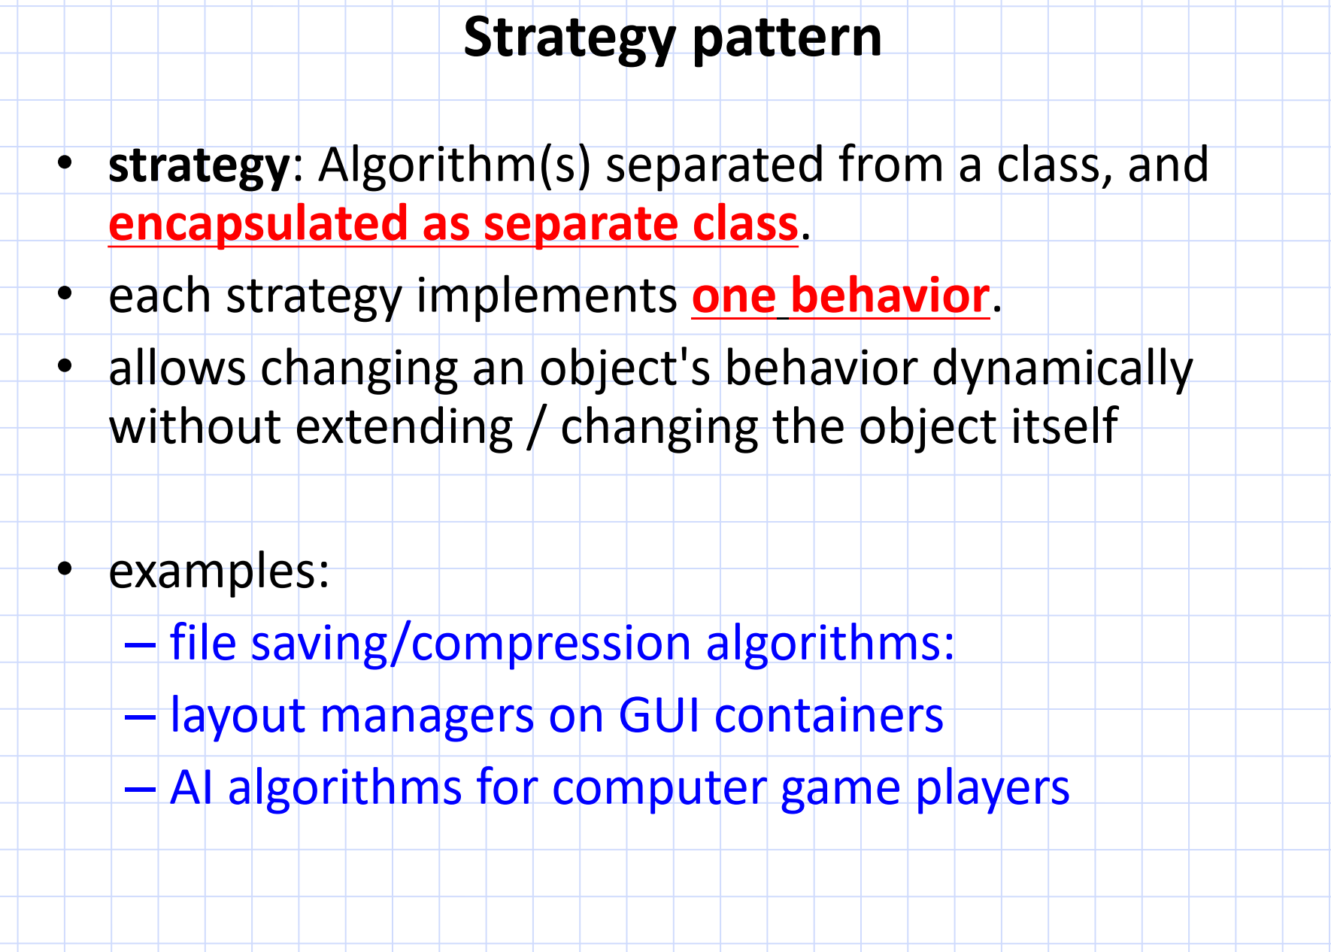
ZIP, RAR, or TAR
Grid layout or Flow layout
Aggressive Strategy, Defensive Strategy
or Balanced Strategy

Slide 13
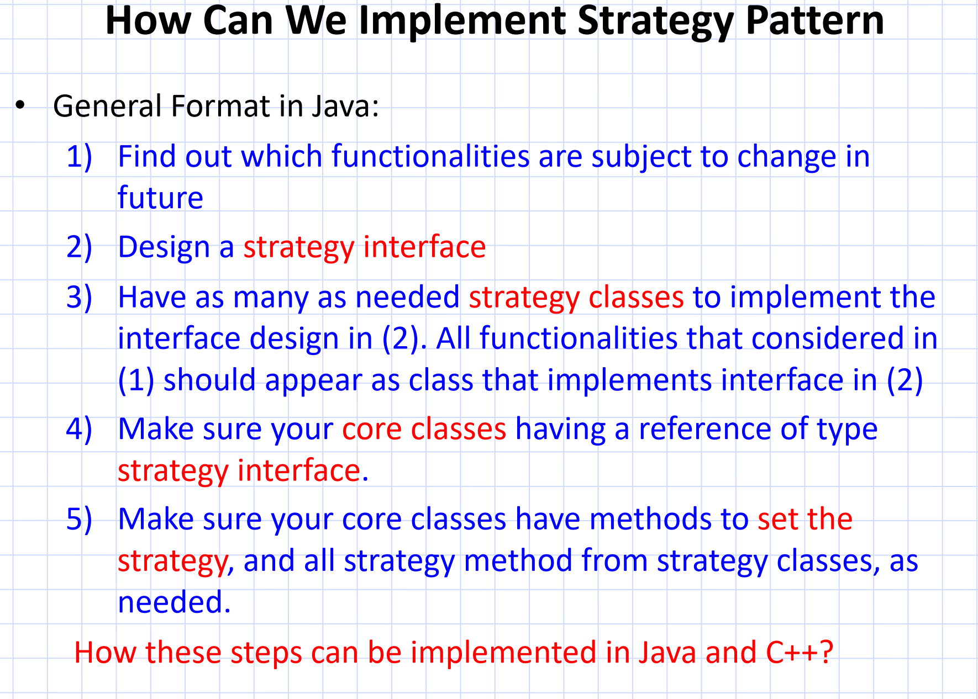
Compression algorithms (e.g., ZIP, RAR, TAR)
CompressionStrategy
compress()
ZipCompressionStrategy, RarCompressionStrategy,
TarCompressionStrategy, CompressionStrategy
Compressor class should have a
reference to CompressionStrategy
Compressor class could have a setCompressionStrategy()

Slide 14
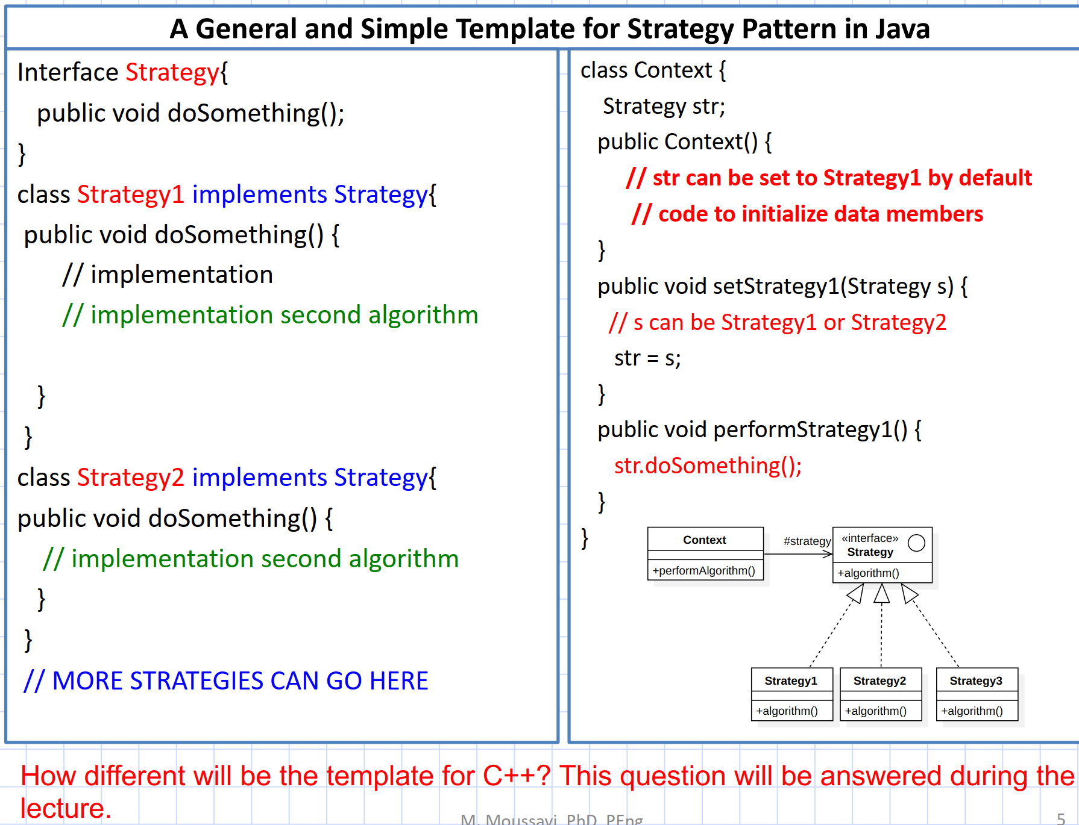

Slide 15
C++
// Context Class using references
class Context {
private:
Strategy& strategy_; // Reference to a Strategy object
public:
Context(Strategy& strategy) : strategy_(strategy) {}
// Setter to change strategy at runtime
void setStrategy(Strategy& strategy) {
strategy_ = strategy;
}
// Perform the current strategy's action
void performStrategy() const {
strategy_.doSomething();
}
};
#include <iostream>
// Strategy Interface
class Strategy {
public:
virtual void doSomething() const = 0; // Pure virtual function
virtual ~Strategy() = default; // Virtual destructor
};
// Concrete Strategy 1
class Strategy1 : public Strategy {
public:
void doSomething() const override {
std::cout << "Performing Strategy 1\n";
}
};
// Concrete Strategy 2
class Strategy2 : public Strategy {
public:
void doSomething() const override {
std::cout << "Performing Strategy 2\n";
}
};
int main() {
Strategy1 strategy1;
Strategy2 strategy2;
// Create a context with Strategy1
Context context(strategy1);
context.performStrategy(); // Outputs: Performing Strategy 1
// Change strategy to Strategy2 at runtime
context.setStrategy(strategy2);
context.performStrategy(); // Outputs: Performing Strategy 2
return 0;
}

Slide 16
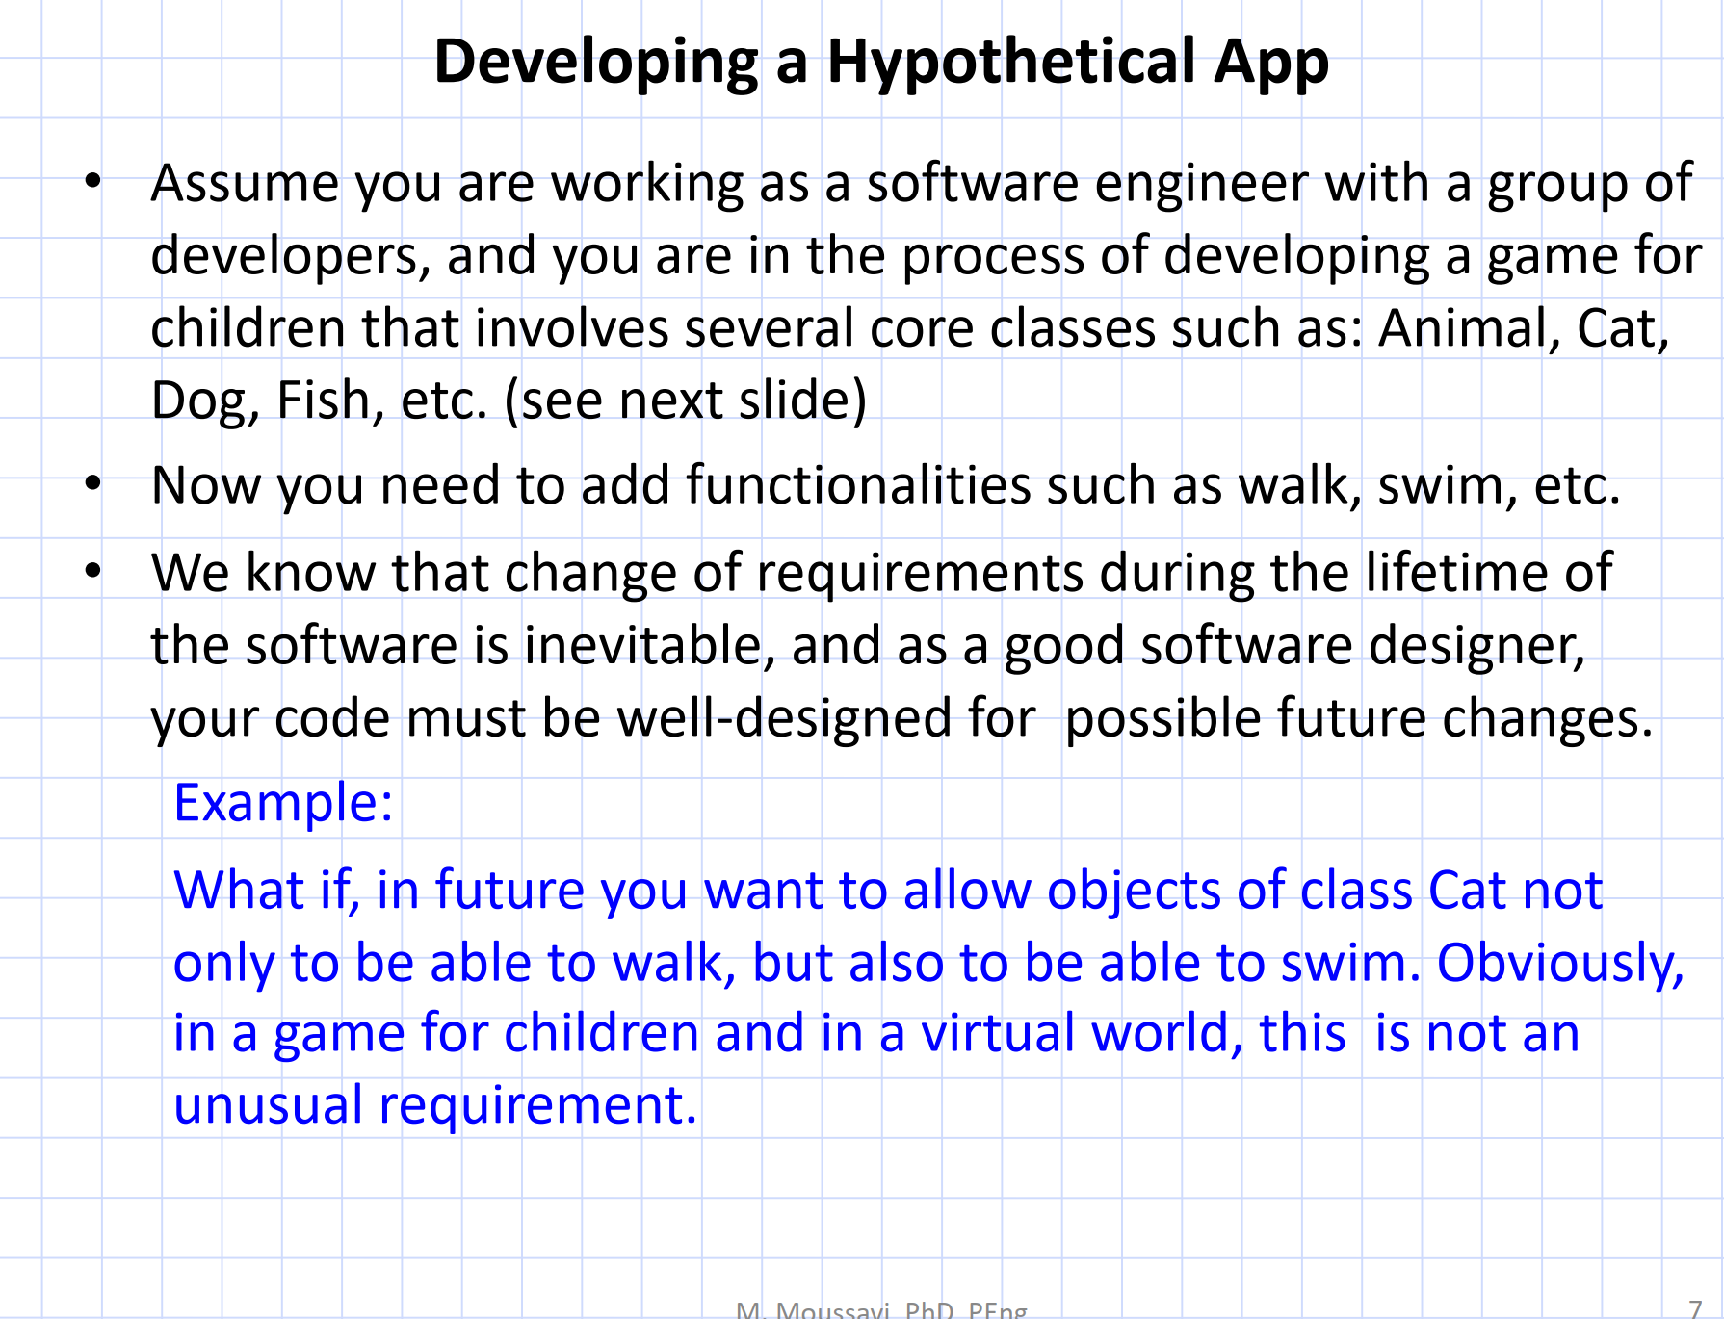

Slide 17
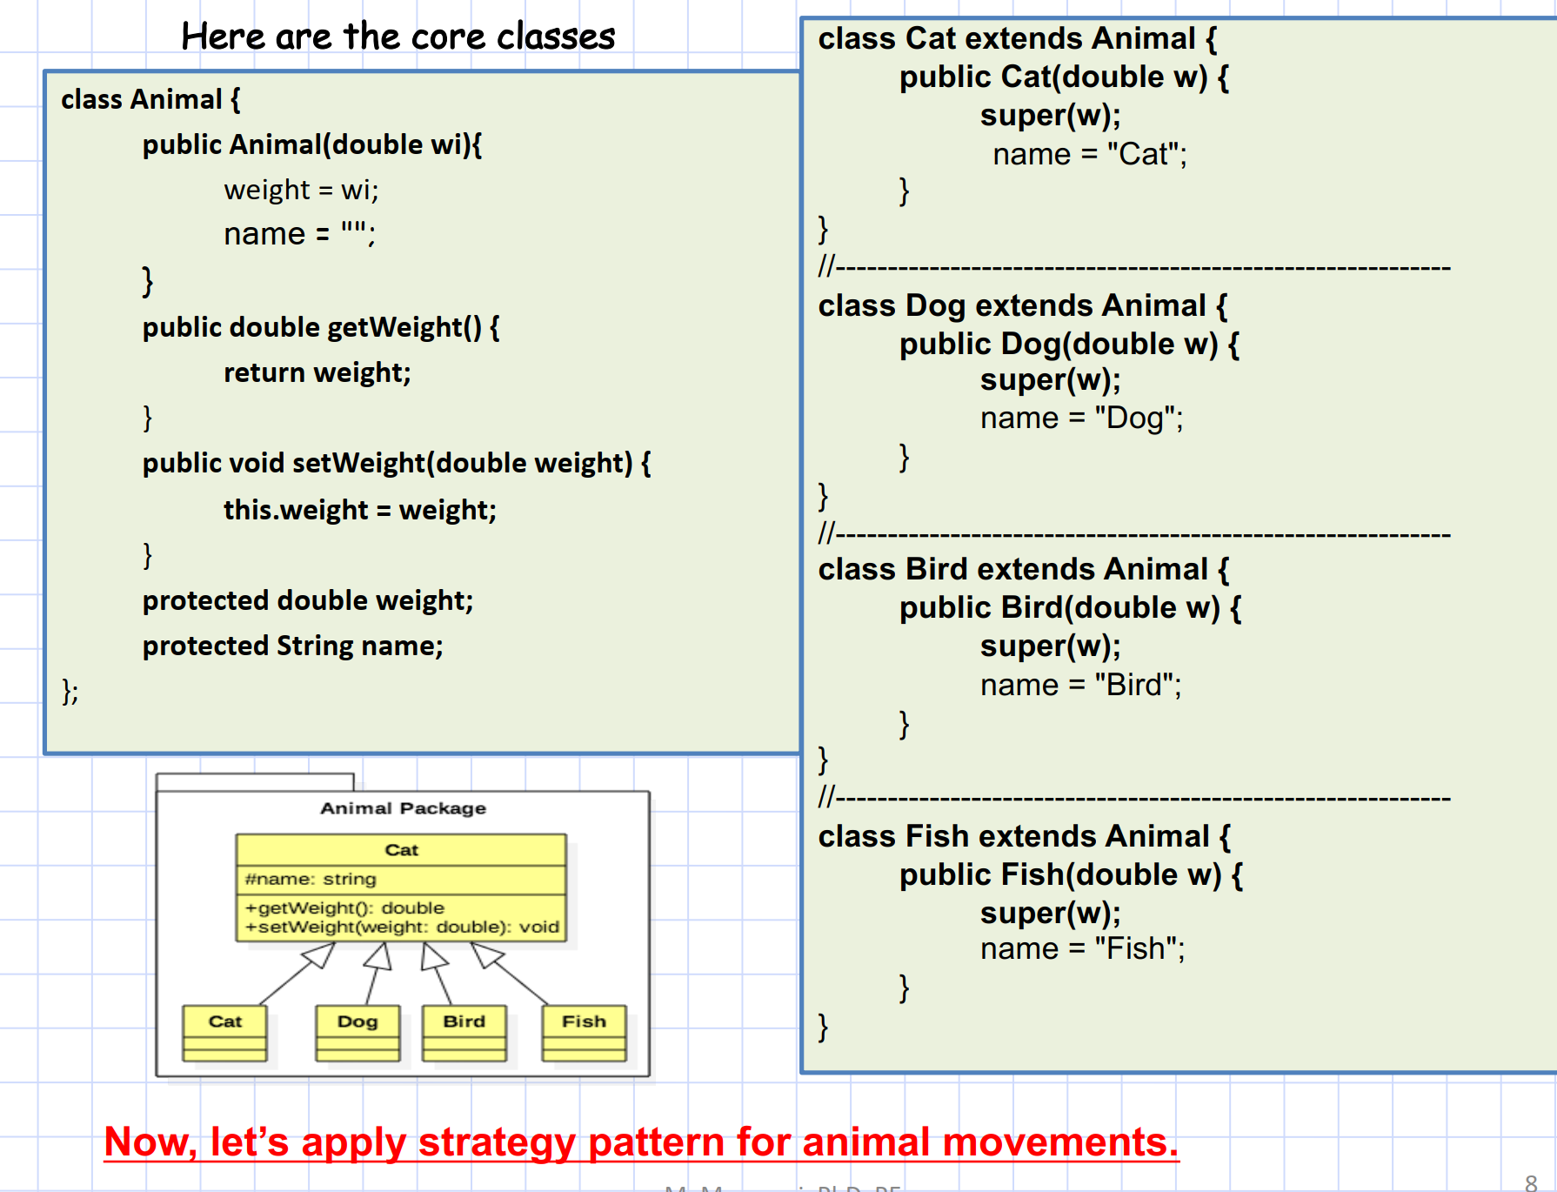

Slide 18
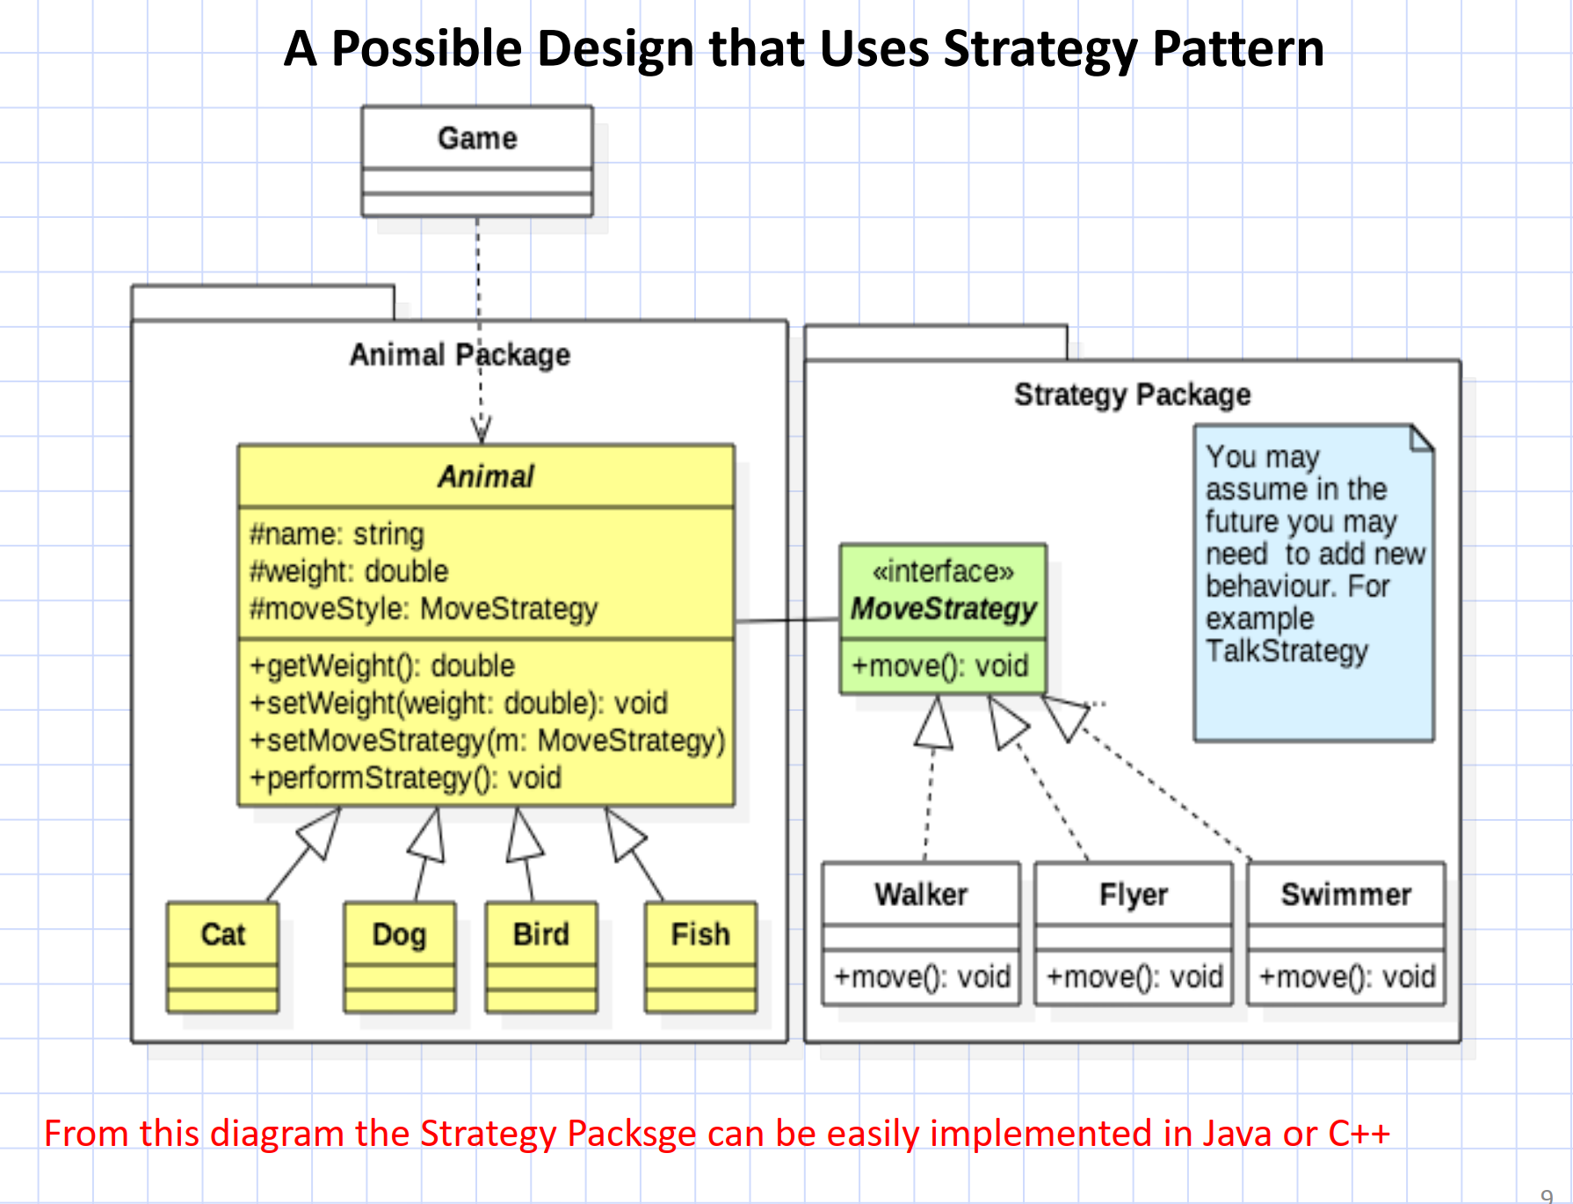

Slide 19
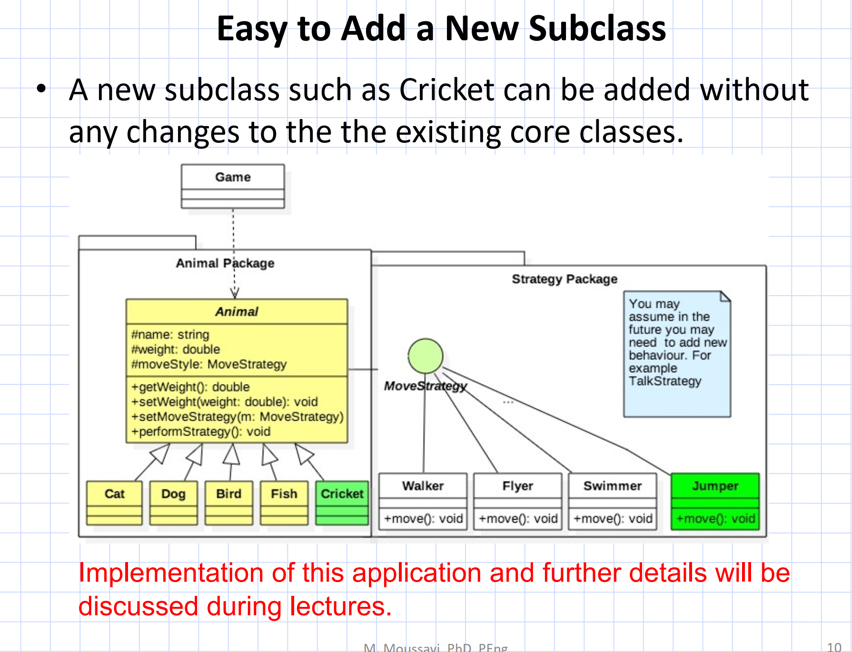

Slide 20
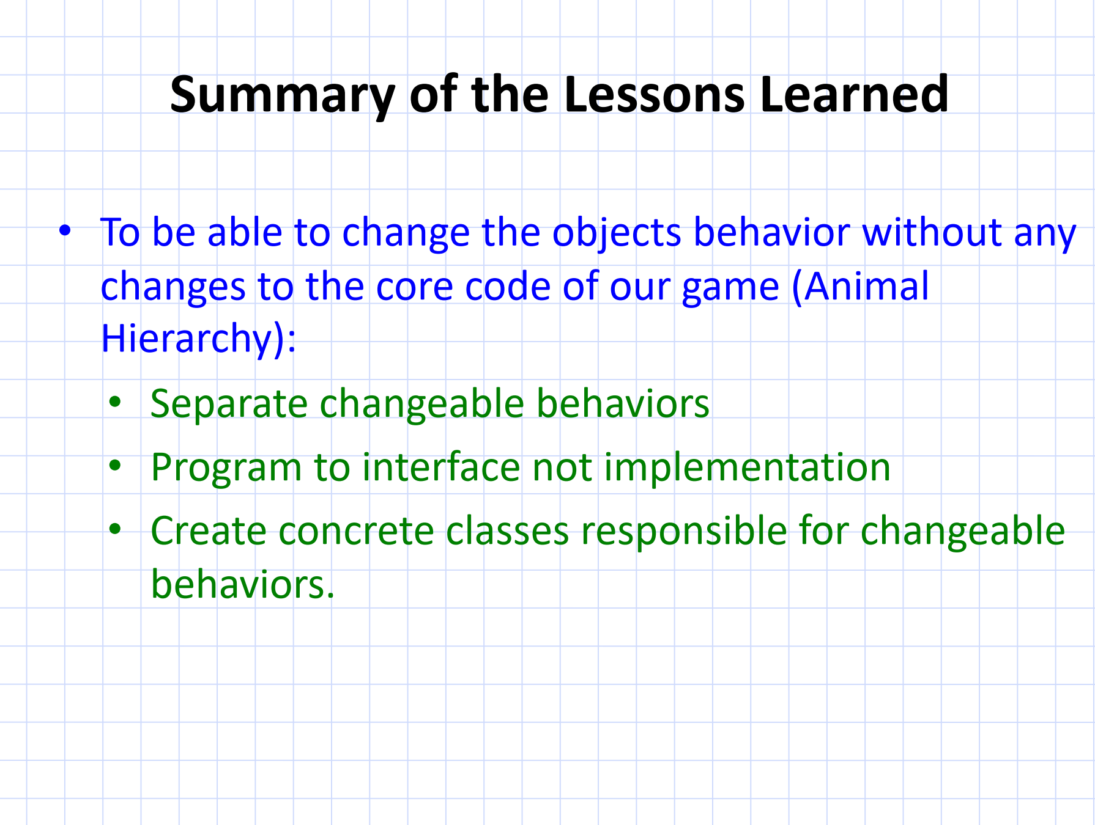

Slide 21
